Slide 1

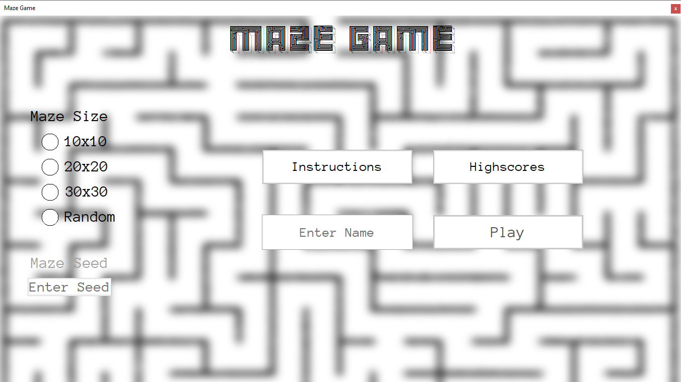
Welcome to the Maze Game. Let’s get started!
First of all, we need to enter a name. Click the ‘Enter Name’ textbox above!

Slide 2
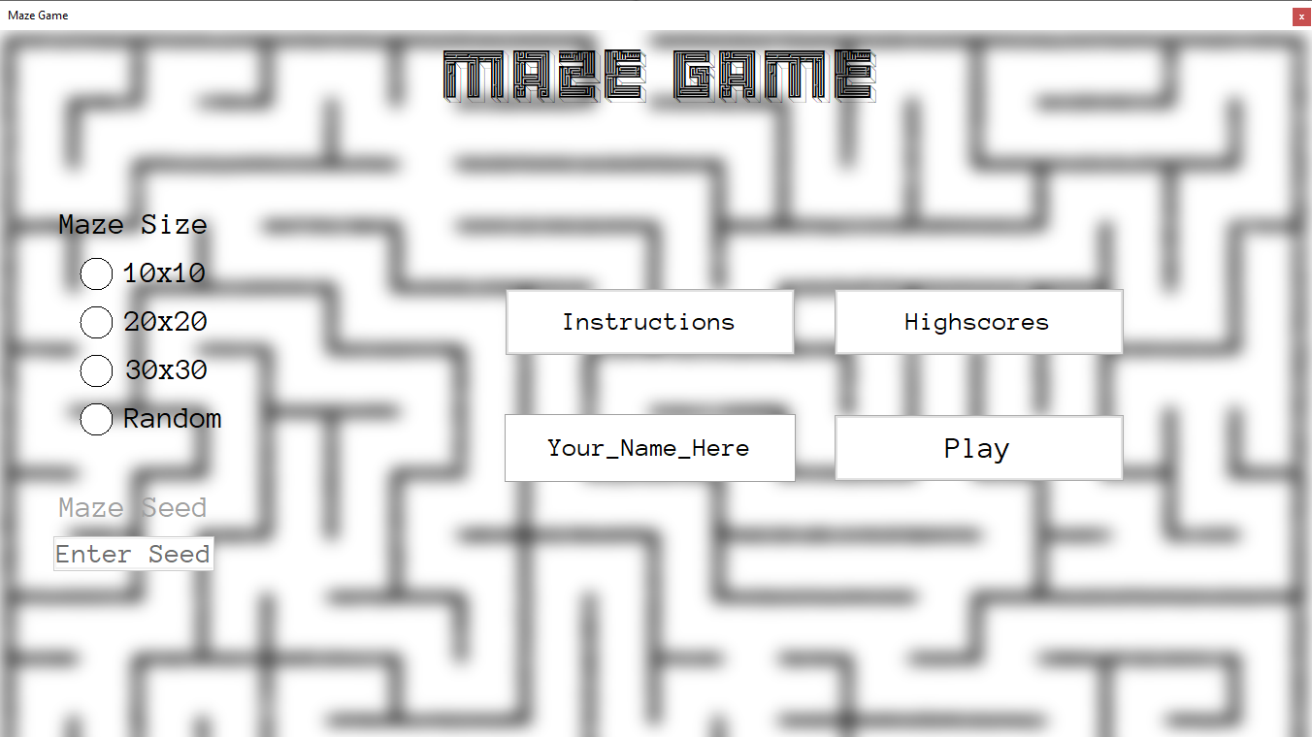
Now, let’s select a difficulty. It’s your first time playing so 10x10 is a good idea.

Slide 3
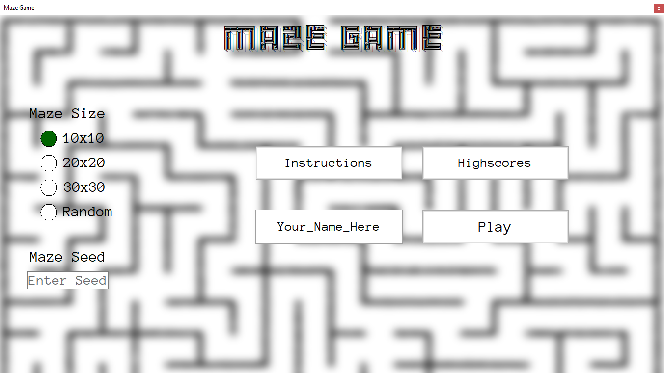
We can enter a maze seed if we wish to. In this case, we’ll enter the seed ‘CAFE’ (which is a valid hexadecimal number).

Slide 4
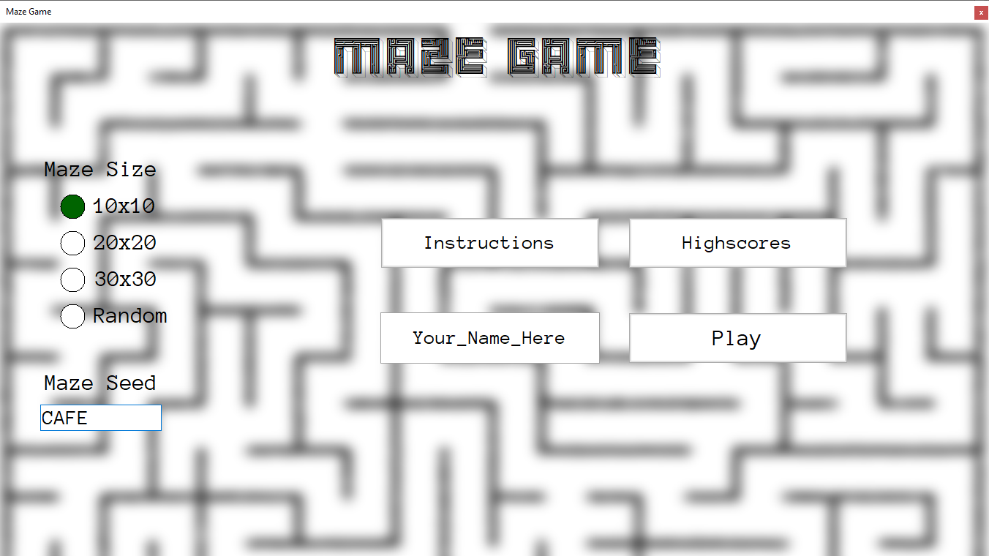
Now we’re all set to begin playing the game – so let’s go!

Slide 5
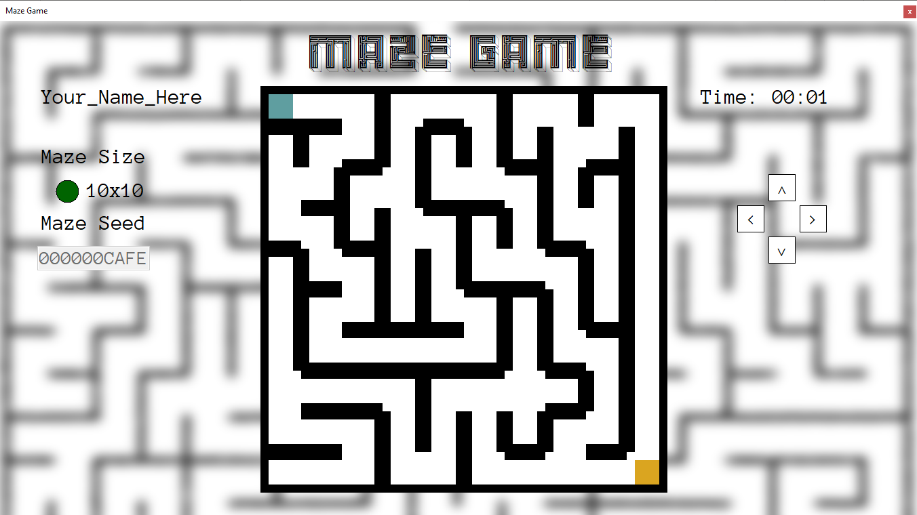
We start up here…
On this side is the timer and the gamepad, which we can use to control our player.
Let’s move to the right to begin moving through the maze.
All the information we have entered is on this side of the game screen.
And want to get here…

Slide 6
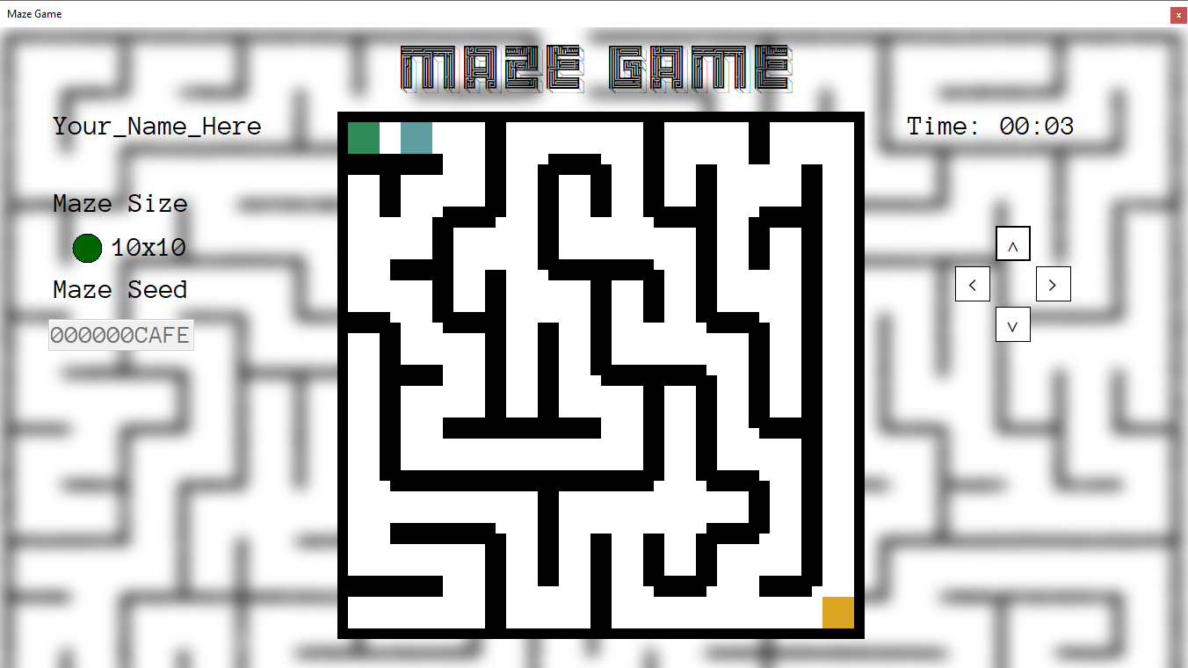
Hooray! We’ve moved one cell to the right. Let’s move one more.

Slide 7
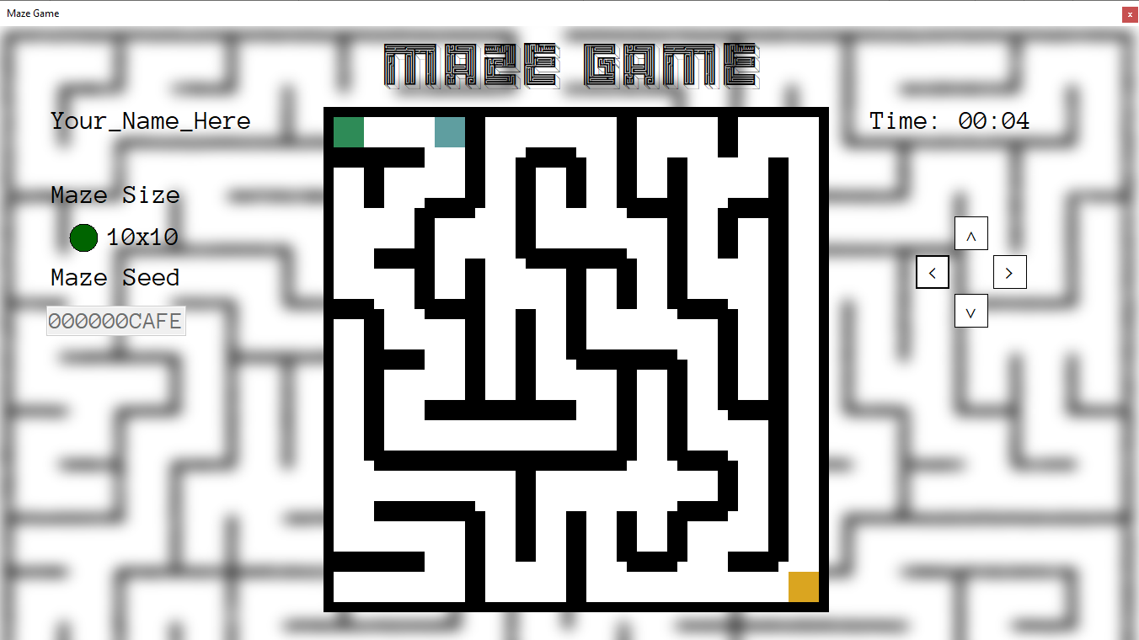
We now need to move down one cell.

Slide 8
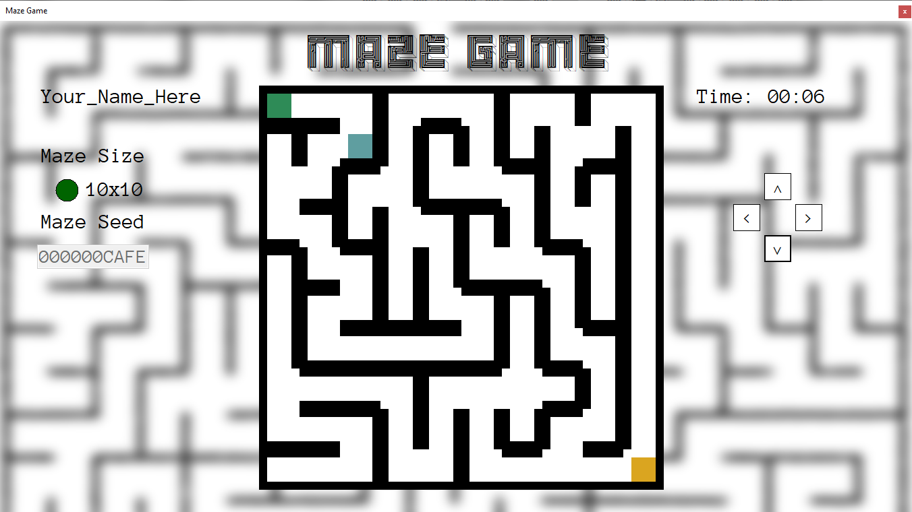
You’re getting the hang of this!

Slide 9
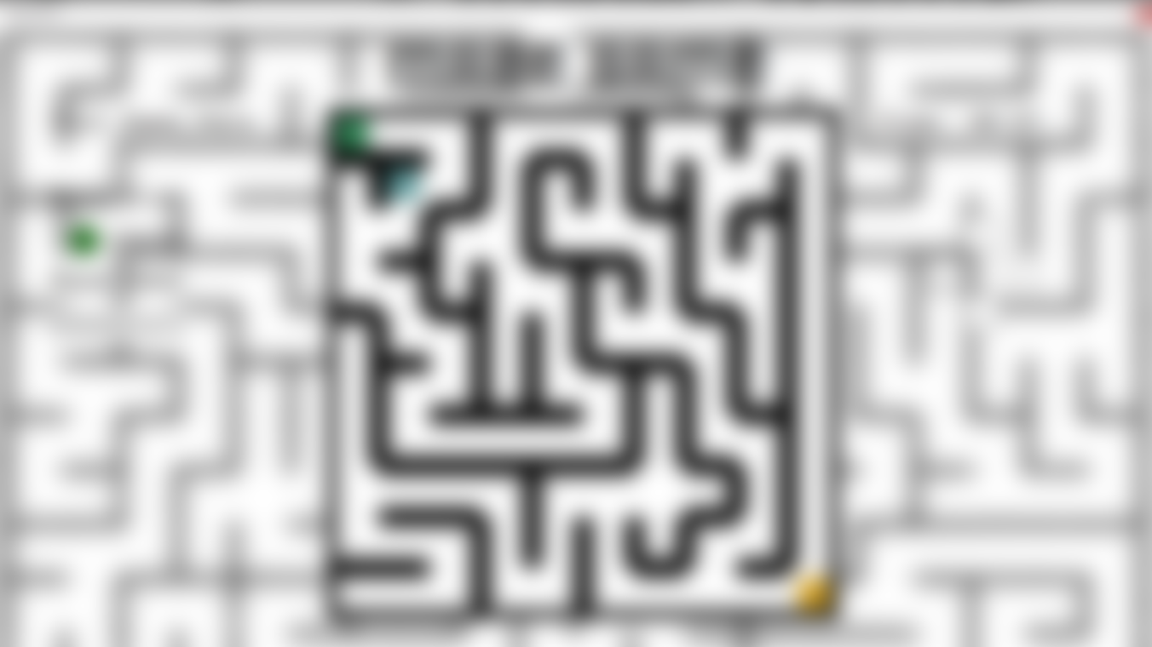
You seem to be getting pretty good at this game! I won’t keep any more of your time here; let’s skip to the end of the maze so you can get to playing the actual game!
Skip To End
This won’t happen in the actual game, don’t worry ☺

Slide 10
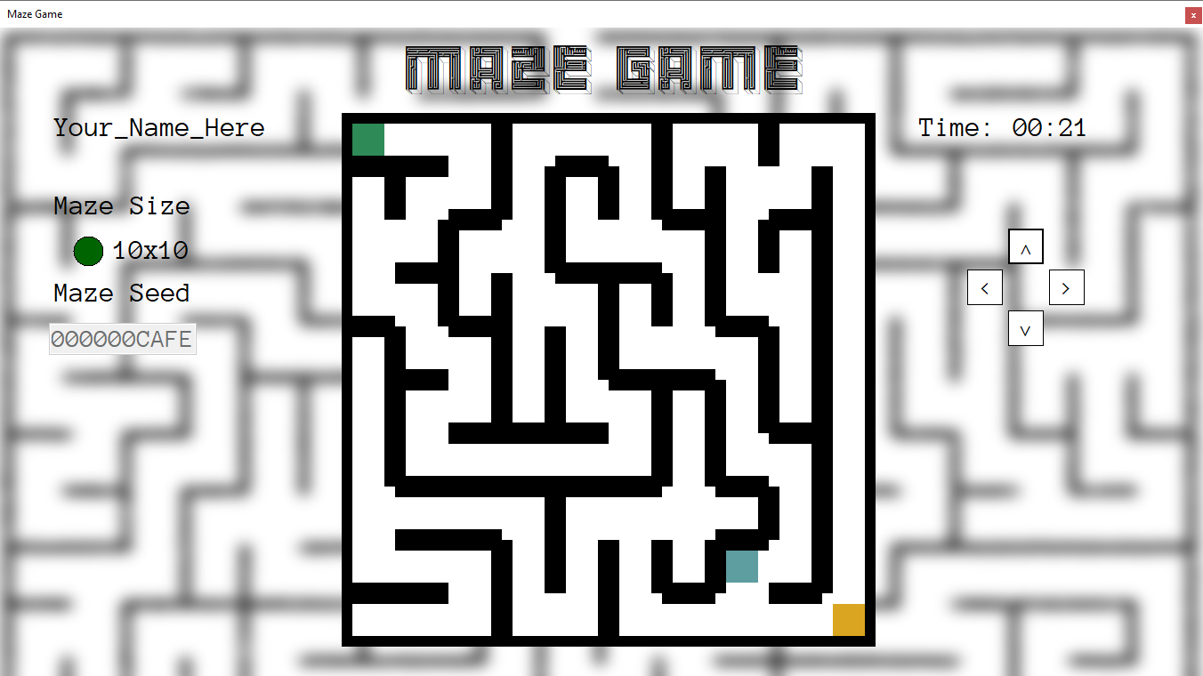
No more hints; best of luck completing the maze, you got this!

Slide 11
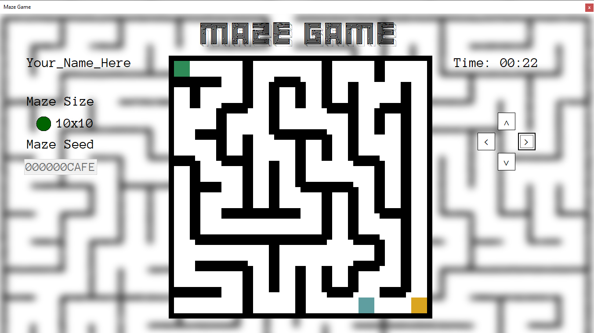
Almost there…

Slide 12
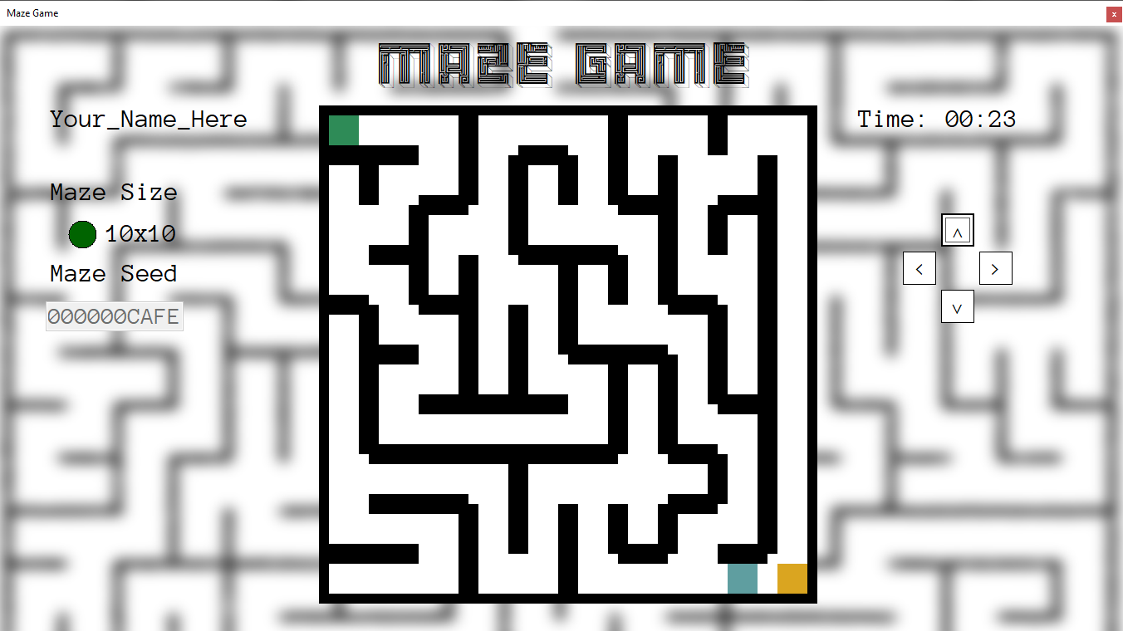
One more!

Slide 13
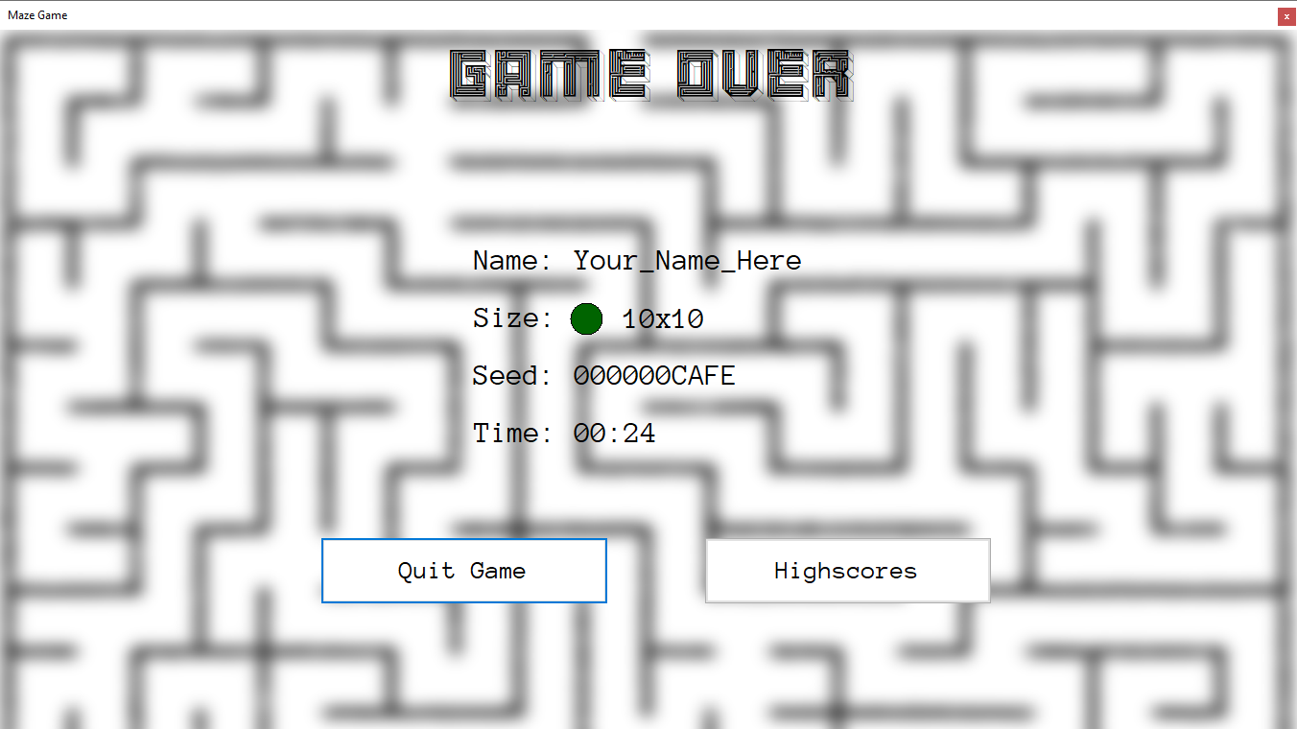
Well done on completing your first maze! Here you can see a breakdown of the game information, and you can either quit and play again, or look at the highscores.

Slide 14
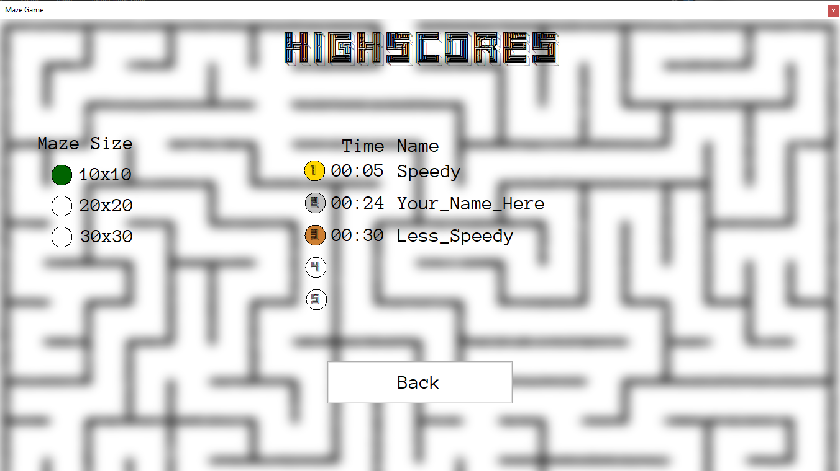
Not bad for your first time! You can check the other highscores by clicking the maze sizes above – try to get to 1st on all of them!

Slide 15
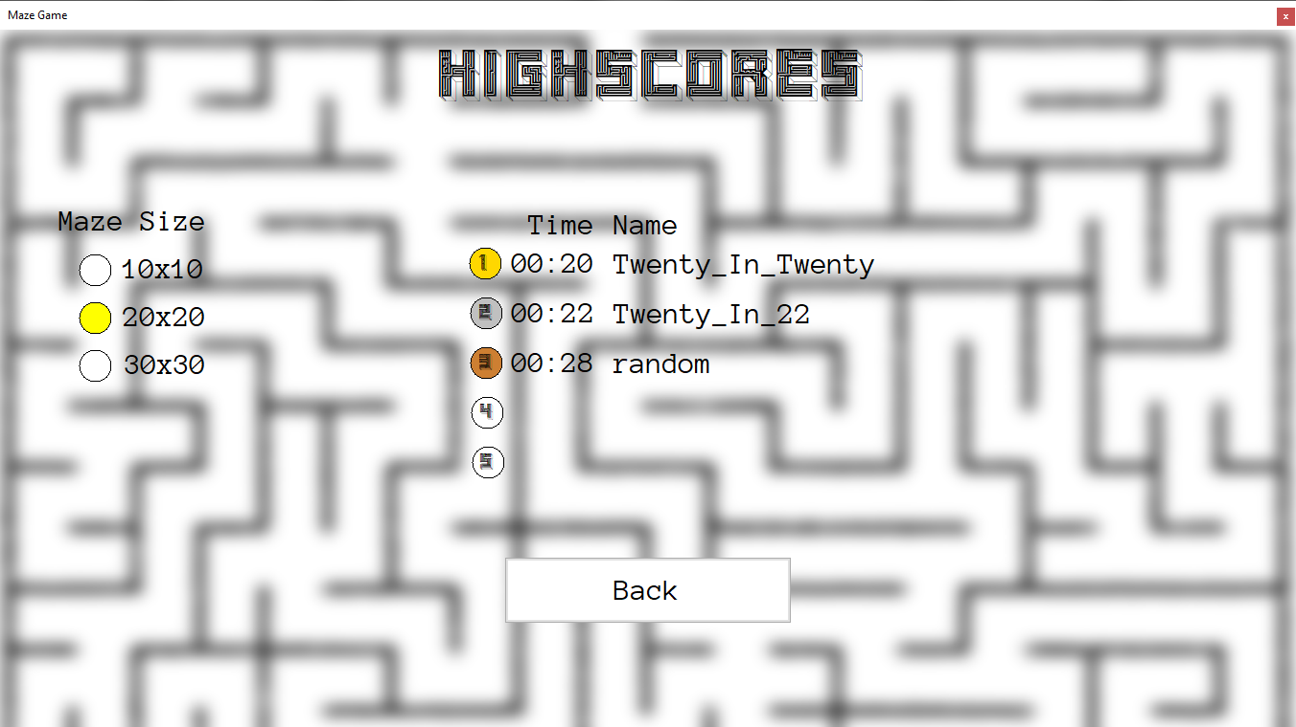

Slide 16
